Slide 1
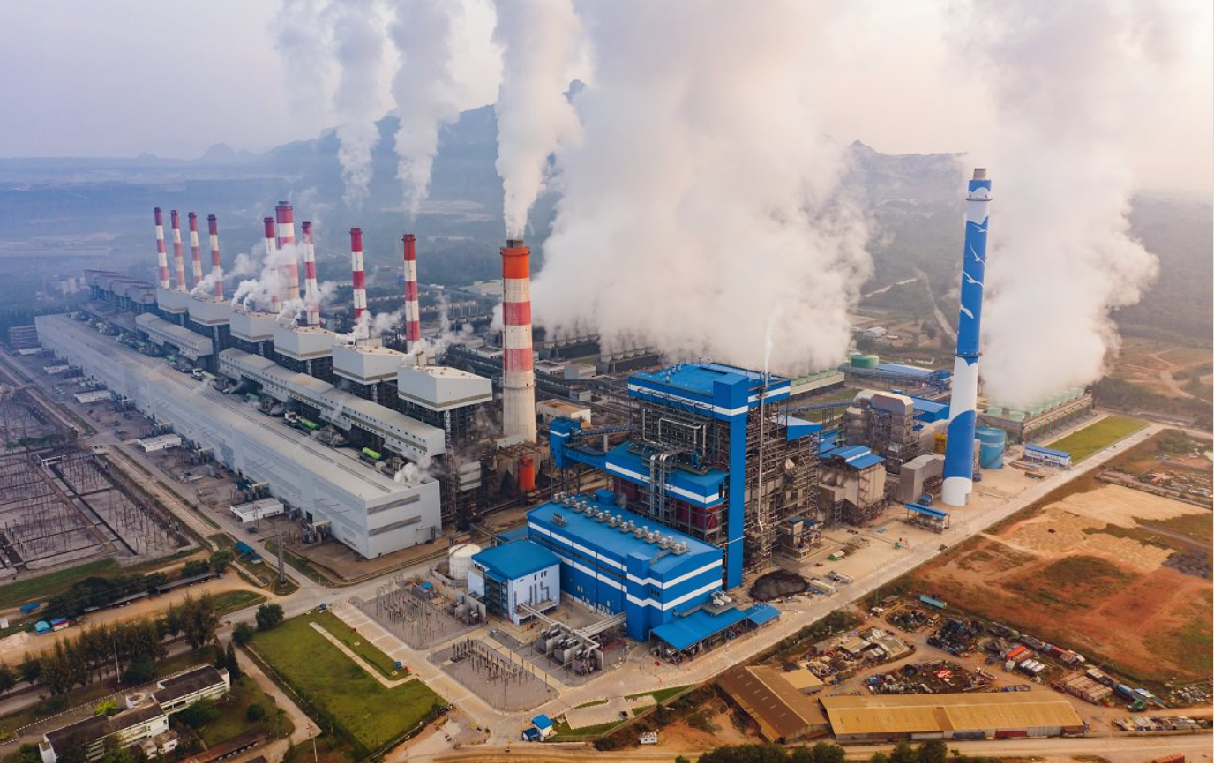
Supplemental Steam Electric Rule:
Information for Communities

Slide 2
Zoom Meeting Housekeeping
Audio is available through your computer’s mic and speakers or by telephone.
Type questions into the Chat box in the bottom dashboard.
To raise your hand, click the “Reactions” icon, in your dashboard, then click “Raise Hand.”
Please feel free to ask questions throughout the presentation.
Please contact Morgan.Collins@erg.com if you are having technical issues with Zoom.

Slide 3
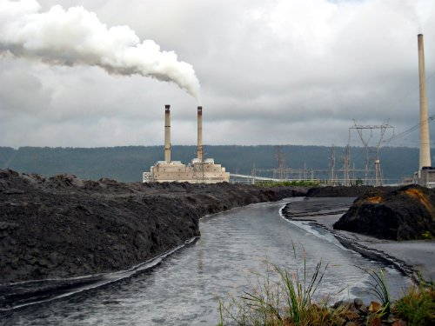
Why are we here? (Introduction)
The U.S. Environmental Protection Agency (EPA) is a federal government agency whose mission is to protect human and environmental health.
EPA can do this through laws that limit pollution from industrial sources into the environment.
This meeting is intended to discuss water pollution, specifically from local power plants.

Slide 4
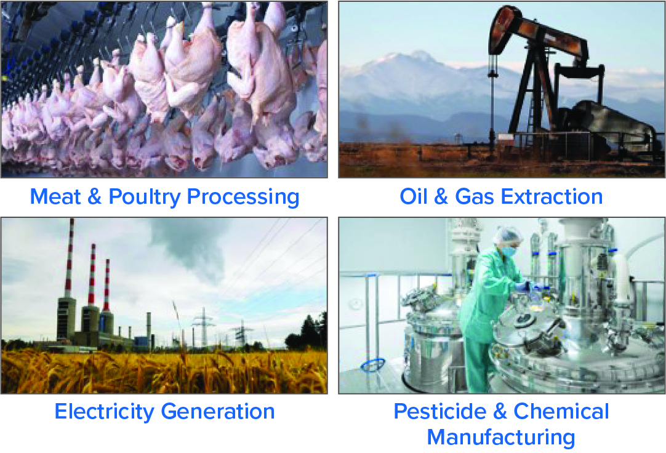
What is the Effluent Limitations Guidelines Program?
Effluent Limitations Guidelines (ELG) sets national laws (regulations) to limit pollution into surface waters–like lakes, rivers, and streams–from industrial sources.
Steam Electric ELG sets standards for cleaning polluted water from power plants that use coal to produce electricity.
Supplemental
Steam
Electric
Rule
Examples of industrial sources regulated by ELGs include:

Slide 5
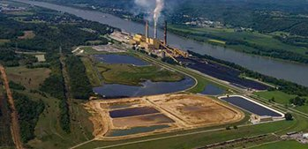
What is the Supplemental Steam Electric Rule?
In August 2021, the EPA announced that it will be developing limits on polluted water released by coal-fired power plants.
Previously, EPA updated limits for coal-fired power plants in 2015 and 2020.
Power plants must clean any polluted water before it flows into nearby lakes, rivers, and streams.
The EPA can require plants to treat polluted water before they discharge it or prevent them from discharging the water at all.
3

Slide 6
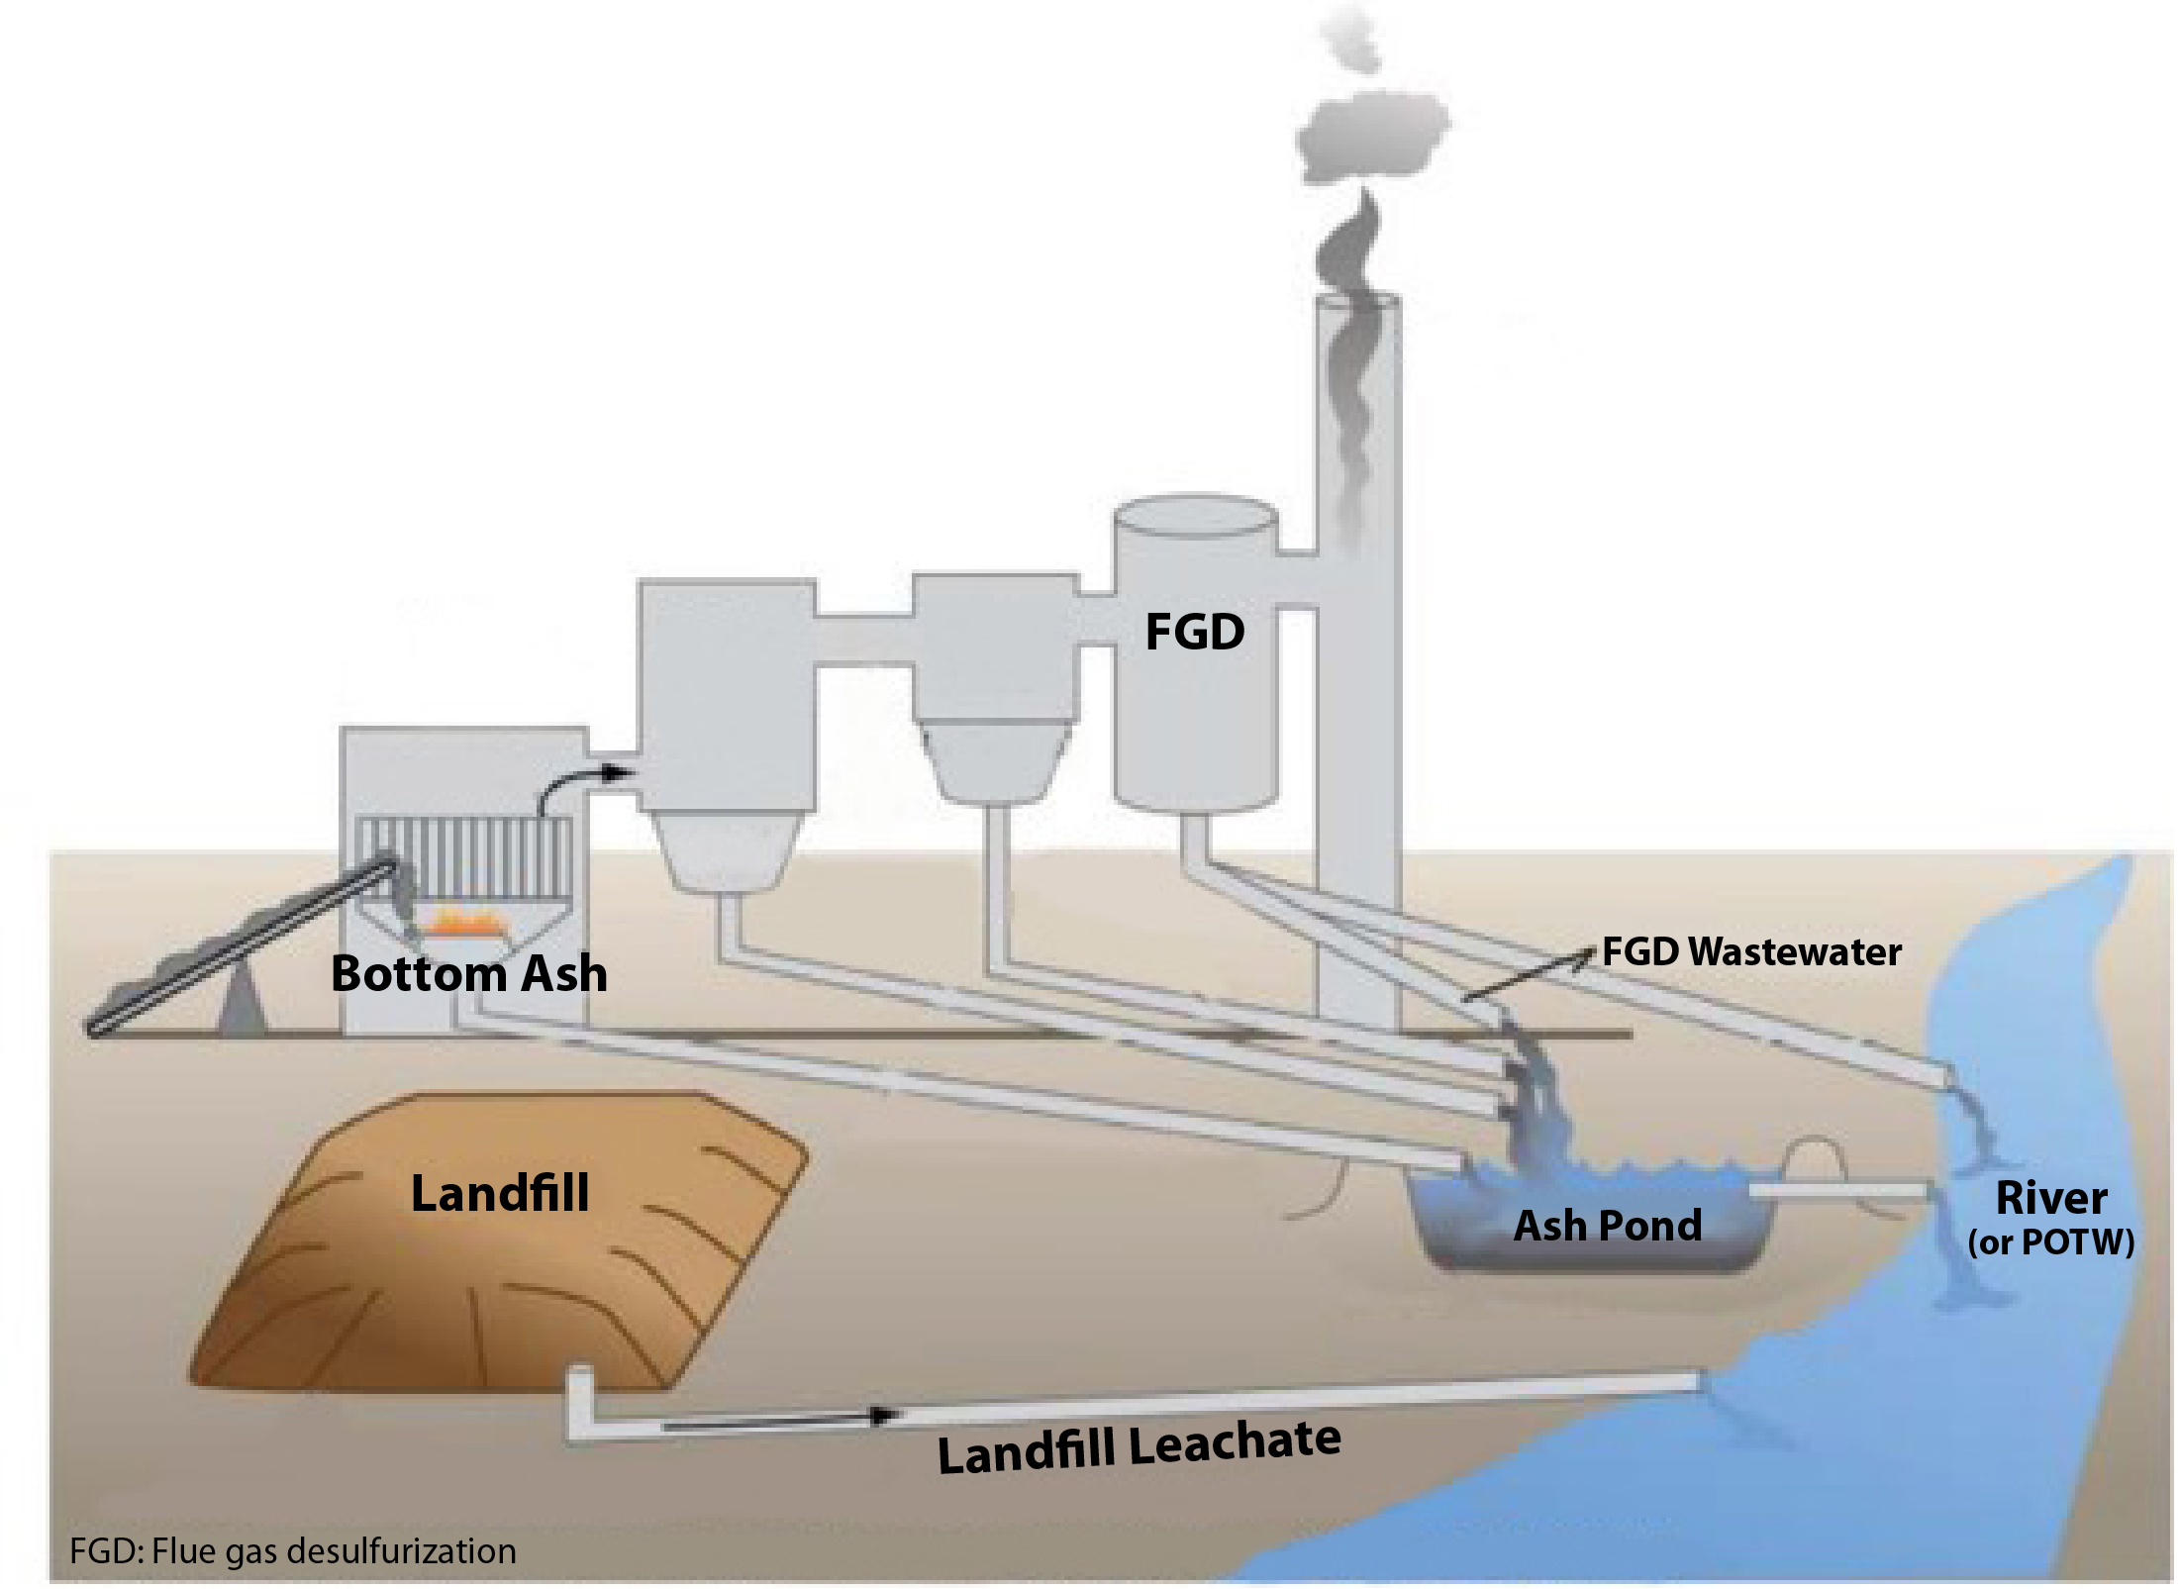
What are the types of polluted water?
The Supplemental Steam Electric Rule will update standards for different types of polluted water released by coal-fired power plants:
Bottom ash transport and purge water: polluted water containing ash from burning coal
FGD wastewater: polluted water from wet air pollution treatment
Legacy wastewater: polluted water created and stored in ash ponds before the Supplemental Steam Electric Rule goes into effect
Landfill leachate: polluted water from ash ponds and landfills
3

Slide 7
Why does your community’s input matter?
EPA is conducting an environmental justice (EJ) analysis to look at the pollution exposure for potentially affected communities. EPA would like to meet with community members to talk about the following topics:
Ideas and strategies for limiting pollution from power plants.
Concerns from community members related to power plants or other sources of pollution; nearby rivers, lakes, and streams; or their drinking water.
Community health, social or economic concerns.
4

Slide 8
How will your input be used by EPA?
EPA will consider community input as it develops the requirements for power plants. EPA will complete calculations (analysis) on pollution exposures and health effects across potentially affected communities.
EPA will post information for communities to its Supplemental Steam Electric Rule website (https://www.epa.gov/eg/2021-supplemental-steam-electric-rulemaking) including:
How EPA used the community input.
The findings of the analysis.
Next steps in the regulation process.
Opportunities for communities to continue engagement with EPA.
5

Slide 9
Discussion

Slide 10
Questions and comments are welcome!
If you have questions or comments on the Supplemental Steam Electric Rule, please contact:
Richard Benware
Email: benware.richard@epa.gov
Phone: 202.566.1369
If you have questions or comments on the EJ Analysis, please contact:
Julia Monsarrat
Email: monsarrat.julia@epa.gov
Phone: 202.566.2887

Slide 11
Appendix

Slide 12
EPA’s Statutory Authority
Under the authority of the Clean Water Act (CWA), EPA establishes regulations that apply to categories of industrial wastewater dischargers.
These regulations are known as ELGs.
The CWA section 304(b) requires EPA to annually review and, if appropriate, revise ELGs. Every other year, EPA publishes a plan for new and revised ELGs, after public review and comment.
The Steam Electric Power Generating sector is considered a regulated industry.
5

Slide 13
Technology-Based Effluent Limitations
Technology-based effluent limitations (TBELs) require a minimum level of treatment of pollutants for point source dischargers based on available treatment technologies.
The discharger can use any available technology to meet the limits.
The Supplemental Steam Electric Rule is based on TBELs.
One example of a potential TBEL is chemical precipitation technology used to treat FGD wastewater. This is a tank-based system designed primarily to remove suspended solids.
5

Slide 14
Water Quality-Based Effluent Limitations
In some cases, TBELs alone will not achieve the applicable water quality standard.
The CWA allows development of water quality-based effluent limitations (WQBELs) to ensure that the water body can meet its water quality goals with the proposed discharge.
Permit writers develop WQBELs based on site-specific factors. They can also be derived from Total Maximum Daily Loads (TMDLs).
5

